Slide 1
Starting school in 2023
Update for 2018
1
Notes:
1

Slide 2
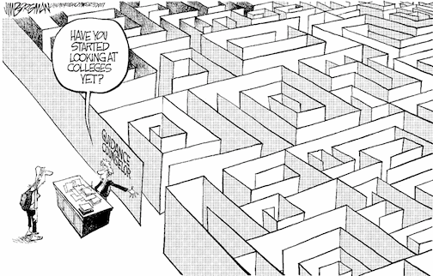
Choosing a school
Have you
started
looking
at schools
yet?

Slide 3
Choosing a school
How do I know which school is right for my child?
Who can help me make that decision?

Slide 4
Choosing a school
Talk to your child
find out what is best for them
consider how they will travel to school

Slide 5
Choosing a school
Choosing a school
Visit the schools
talk to the headteacher & staff
ask for a tour of the school
… however, you will need to check the visiting arrangements with individual schools as access may be restricted post-Covid

Slide 6
Choosing a school
Read the school prospectus
it will have detailed information about:
how the school is run
the admissions criteria
available from the school
download from the school website

Slide 7
Choosing a school
Read the primary education booklet published by your home local authority
download Barnet’s booklet at www.barnet.gov.uk/schooladmissions

Slide 8
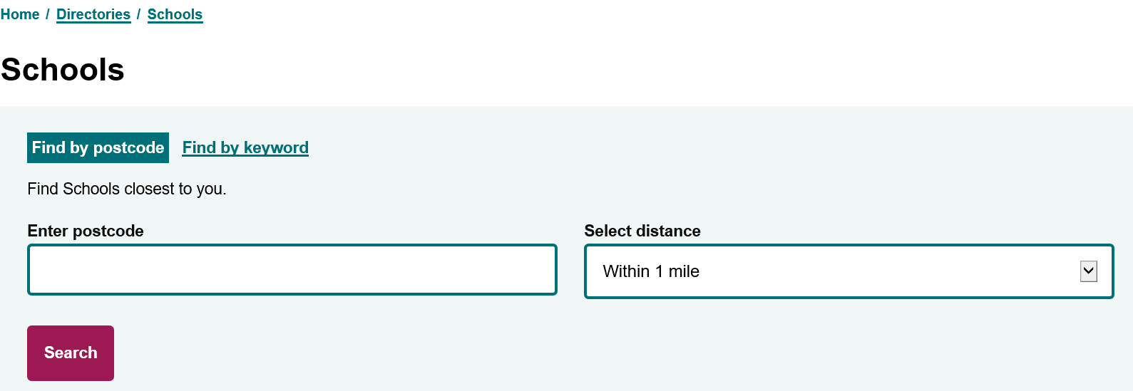
Choosing a school
You can also find details of Barnet primary schools in the Schools Directory at
www.barnet.gov.uk/directories/schools

Slide 9
Choosing a school
Talk to the Customer Contact Centre
the team can offer you advice and answer your questions
how do I contact them?
tel: 020 8359 7651
if you live outside Barnet, you will find the contact details for your admissions team in Barnet’s primary education booklet

Slide 10
Choosing a school
Look at Performance Tables and Ofsted reports
the latest Ofsted reports are available from the Ofsted website www.ofsted.gov.uk
achievement and attainment tables are available at www.gov.uk/school-performance-tables

Slide 11
Choosing a school
Look carefully at the admission criteria for each school
siblings
children of staff
distance

Slide 12
Cut-off Distances Community Primary Schools April 2022
Name of School | Inside priority area | Outside priority area | Name of School | Inside priority area | Outside priority area
Barnfield Primary | All | 0.236 | Goldbeaters Primary | 0.529 | None
Bell Lane Primary | All | All | Holly Park Primary | All | All
Brookland Infant | All | 0.643 | Livingstone Primary | 0.242 | None
Brunswick Park Primary | All | 0.678 | Manorside Primary | 0.243 | None
Chalgrove Primary | All | All | Martin Primary | All | 1.581
Church Hill Primary | All | All | Monkfrith Primary | All | 0.531
Colindale Primary | 0.361 | None | Moss Hall Infant | All | 0.917
Coppetts Wood Primary | 0.383 | None | Northside Primary | 0.178 | None
Courtland Primary | All | 0.561 | Queenswell Infant | All | All
Cromer Road Primary | All | 0.455 | Sunnyfields Primary | 0.292 | None
Danegrove Primary | 0.866 | None | The Orion Primary | All | 0.584
Deansbrook Infant | All | All | Tudor Primary | All | All
Dollis Primary | All | All | Underhill Primary | All | All
Edgware Primary | All | All | Wessex Gardens Primary | All | All
Fairway Primary | All | 0.99 | Whitings Hill Primary | 0.638 | None
Foulds Primary | All | 0.238 | Woodcroft Primary | All | All
Frith Manor Primary | All | All | Woodridge Primary | All | 0.565
Garden Suburb Infant | All | All

Slide 13
Choosing a school
Check the admission limit
each school has a set number of places available
this means some schools only have one form of entry (30 places)
larger schools have 3 or 4 forms of entry

Slide 14
How do I apply?
How soon can I apply?
The online application system opened on 1 September 2022
Where do I apply?
You need to apply online at www.eadmissions.org.uk
(or check your Local Authority’s website if you live outside London)
What if I don’t have a computer at home?
You can:
use your smart phone or tablet
go to your local library
go to an internet café
ask a friend or relative for help

Slide 15
How do I apply?
How many schools can I apply for?
you can apply for up to six schools
you should rank the schools in your order of preference
it is important to think carefully about the order as you will not be able to change it after the closing date
Can I apply to schools outside Barnet?
yes, you must include all your chosen schools on the single application form, whether they are inside or outside the borough where you live

Slide 16
How do I apply?
Realistic Preferences
if you only select one school, it will not increase your chances of getting a place at the school and your child will be considered for that one school only
if this is unsuccessful, you may miss out on an offer which could have been made at another school and you are likely to be offered a place at the nearest school with a vacancy
it is important to make realistic school choices to increase your chances of securing an offer and to avoid disappointment
it is important to check how places were offered last year
remember the cut-off distances are just a guide and will change every year……
……just because you live nearer to the school than the last child offered a distance place last year, it doesn’t mean your child is guaranteed a place

Slide 17
How do I apply?
Do I need to fill in any other forms?
All voluntary aided schools and some foundation schools & academies will ask you to complete a Supplementary Information Form (SIF)
the SIF will ask for additional information, for example
faith schools will ask about church attendance and request a priest’s reference
Catholic schools may ask for a Certificate of Catholic Practice (CCP)
Jewish schools will also ask you to complete a Certificate of Religious Practice (CRP), which must be signed by a Rabbi
SIFs, CCPs and CRPs must be returned to the individual schools

Slide 18
How do I apply?
How do I apply?
What else do I need to provide?
Proof of address
your permanent address must be used on the application form
you must not use a temporary address or an address of convenience, this includes a child minder’s address, a business address or the address of a relative or friend
if you own a property previously used as a home address and apply from another address, the second address will be treated as an address of convenience
if you have moved in recent months you may be asked to provide proof of the new address and proof that you have disposed of the previous address
A copy of your child’s birth certificate

Slide 19
Fraudulent address
each year a small number of parents provide a false address to get a school place
in doing so they could be depriving your child of a place
providing false information is a criminal offence
if you know someone who intends to use a false address, you can report this in confidence to the Corporate Anti-Fraud Team
report it online at www.barnet.gov.uk/anti-fraud
call the fraud hotline on 020 8359 2007

Slide 20
How do I apply?
When is the closing date?
15 January 2023
the online system will close at 12 midnight on 15 January

Slide 21
How do I apply?
What happens if I miss the closing date?
Your application will be given lower priority than on-time applications
in previous years some children did not get a place at their older sibling’s school because their applications were late
some late applications may be treated as ‘on-time’ if there is an exceptional reason (for example illness or you have just moved into the borough)
You must let the Admissions Team know your reason by 9 February 2023

Slide 22
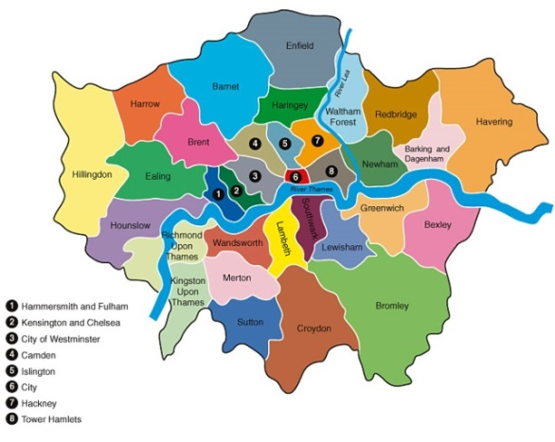
What happens next?
What happens next?
Co-ordinated admissions
the admissions process is co-ordinated by all 33 London boroughs, neighbouring boroughs and other home counties
application lists are exchanged
offer lists are drawn up
offer lists are exchanged

Slide 23
What happens next?
What happens next?
How will places be allocated?
if the school is over-subscribed, the published oversubscription criteria will be applied to decide who can be offered a place
each school listed on the application form will be considered against the individual school’s oversubscription criteria
your order of school preference is not passed to the individual schools.

Slide 24
Offers
Will I be offered more than one school place?
Where the applicant qualifies for a place at more than one school, a place will be offered at the school that was ranked as the higher preference on the application form
any lower preferences will be withdrawn and offered to other children
no child will be offered more than one school.

Slide 25
Offers
When will I hear?
National Offer Day is Monday 17 April 2023
emails will be sent to all applicants in the evening of 17 April
applicants who are not offered their first choice can log in to their eAdmissions account for further information

Slide 26
Offers
Accepting offers
click on the ‘Reply’ button at the bottom of the offer email notification and log into your eAdmissions account and submit your response
places must be accepted by 2 May 2023

Slide 27
No offer
What happens if I don’t get any of my preference schools?
where possible your child will be allocated an alternative school
this will normally be the nearest school with a vacancy
remain on the waiting lists
appeal for a place

Slide 28
Appeals
Appeals
every parent has the right of appeal
appeals are heard by an independent panel
you will have the opportunity to present your case in person

Slide 29
….however
……however
Reception class appeals are nearly always unsuccessful….
This is because….
infant class sizes must not exceed 30 children
infant class appeals are only successful if you can prove that the local authority or the school has made a mistake
or that
the decision not to offer a place was not rational or was outrageous in its defiance of logic

Slide 30
Starting school in 2023
Update for 2018
30
Notes:
30

